Slide 1
Data Structure
Introduction and Preliminaries
Mohammad Gazi Golam Faruque
Associate Professor
Department of Computer Science and Engineering
KHWAJA YUNUS ALI UNIVERSITY

Slide 2
Related CLOs
Course Learning Outcome (CLO)
CLOs | After successful completing this course, students will be able to. | PLO Mapping
CLO1 | Understand the concept of data structures to apply the algorithm for solving problems. | PO1, PO2
CLO2 | Choose a suitable algorithm to organize the data in several structure in computer. | PO4, PO5
CLO3 | Implement the various data structure algorithm for solving real-life problems. | PO2, PO3
CLO4 | Develop the new sustainable data structure to solve the upcoming problems. | PO12
CLO5 | Explore the various operations of linear, non-linear and dynamic data structures. | PO3, PO12

Slide 3
Discuss Topics
Data Structures
Data Structure Operations
Algorithms: Complexity, Time-Space Tradeoff
Data Structure Preliminaries
Mathematical Notation and Functions
Algorithmic Notation
OTHER ASYMPTOTIC NOTATIONS FOR COMPLEXITY OF ALGORITHMS Ω, Θ, O

Slide 4
Data Structures
Data may be organized in many different ways;
The logical or
The mathematical model
of a particular organization of data is called a data structure.

Slide 5
Why Data Structure
The choice of a particular data model depends on two considerations.
First, it must be rich enough in structure to mirror the actual relationships of the data in the real world.
On the other hand, the structure should be simple enough that one can effectively process the data when necessary.

Slide 6
Data Structure Operations
The data appearing in our data structures are processed by means of certain operations.
In fact, the particular data structure that one chooses for a given situation depends largely on the frequency with which specific operations are performed.

Slide 7
Data Structure Operations
The following four operations play a major role in this text:
Traversing: Accessing each record exactly once so that certain items in the record may be processed. (This accessing and processing is sometimes called “visiting” the record.)
Searching: Finding the location of the record with a given key value, or finding the locations of all records which satisfy one or more conditions.
Inserting: Adding a new record to the structure.
Deleting: Removing a record from the structure.

Slide 8
Data Structure Operations
The following two operations, which are used in special situations, will also be considered:
Sorting: Arranging the records in some logical order (e.g., alphabetically according to some NAME key, or in numerical order according to some NUMBER key, such as social security number or account number)
Merging: Combining the records in two different sorted files into a single sorted file

Slide 9
Data Structures Example
Arrays
Stacks
Queues
Linked Lists
Trees
Graphs
Hash Tables

Slide 10
Algorithms: Complexity, Time-Space Trade-off
An algorithm is a well-defined list of steps for solving a particular problem.
One major purpose is to develop efficient algorithms for the processing of our data.
The time and space it uses are two major measures of the efficiency of an algorithm.
The complexity of an algorithm is the function which gives the running time and/or space in terms of the input size.

Slide 11
Data Structure Preliminaries
The development of algorithms for the creation and processing of data structures is a major feature of this text.
The format we have selected is similar to the format used by Knuth in his well-known text Fundamental Algorithms.

Slide 12
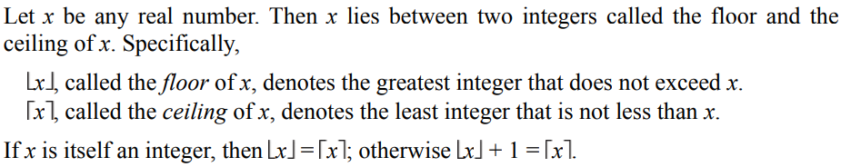
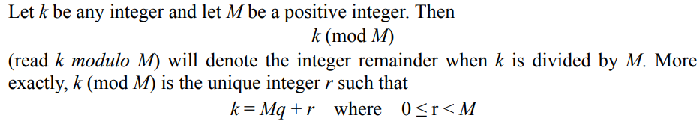
Mathematical Notation and Functions
Floor and Ceiling Functions
Remainder Function; Modular Arithmetic

Slide 13
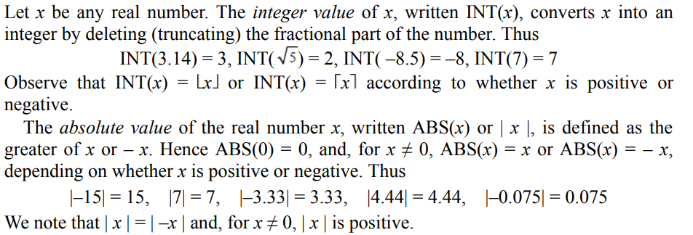
Mathematical Notation and Functions
Integer and Absolute Value Functions

Slide 14
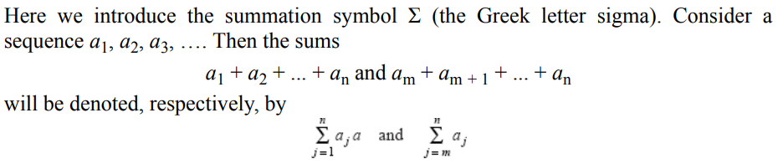
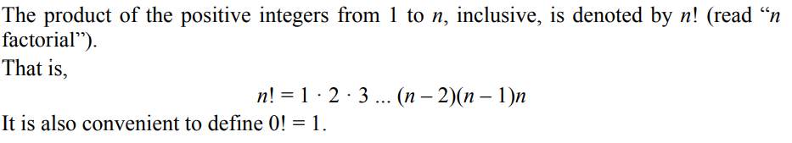
Mathematical Notation and Functions
Summation Symbol: Sums
Factorial Function

Slide 15
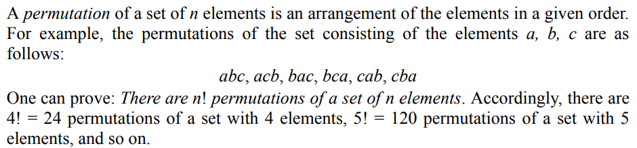
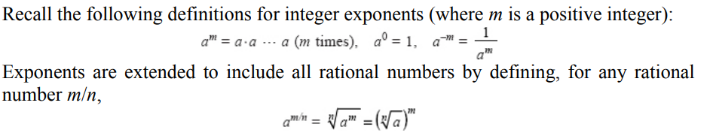
Mathematical Notation and Functions
Permutations
Exponents and Logarithms

Slide 16
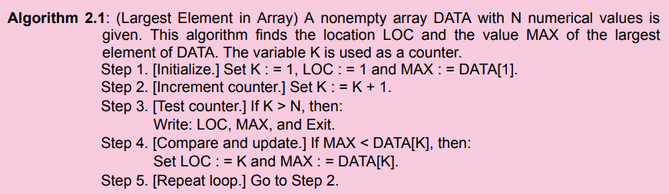
Algorithmic Notation
An array DATA of numerical values is in memory. We want to find the location LOC and the value MAX of the largest element of DATA. Given no other information about DATA, one way to solve the problem is as follows:

Slide 17
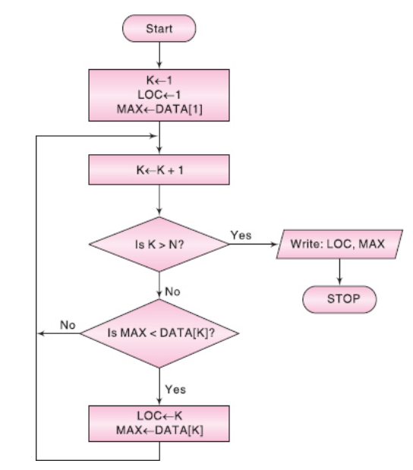
Algorithmic Notation

Slide 18
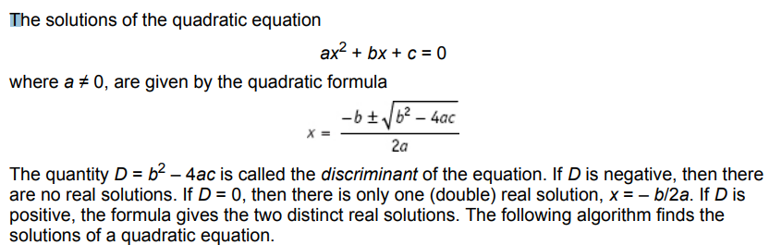
Algorithmic Notation

Slide 19
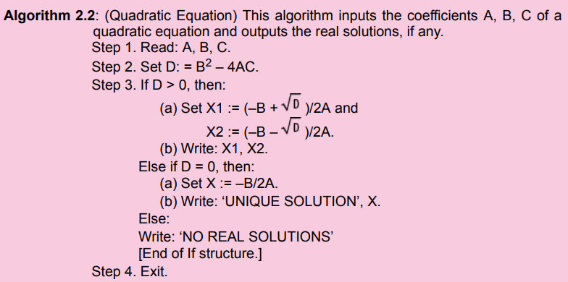
Algorithmic Notation

Slide 20
OTHER ASYMPTOTIC NOTATIONS FOR COMPLEXITY OF ALGORITHMS Ω, Θ, O
The “big O” notation defines an upper bound function g(n) for f(n) which represents the time/space complexity of the algorithm on an input characteristic n.
There are other asymptotic notations such as Ω, Θ, o which also serve to provide bounds for the function f(n).

Slide 21
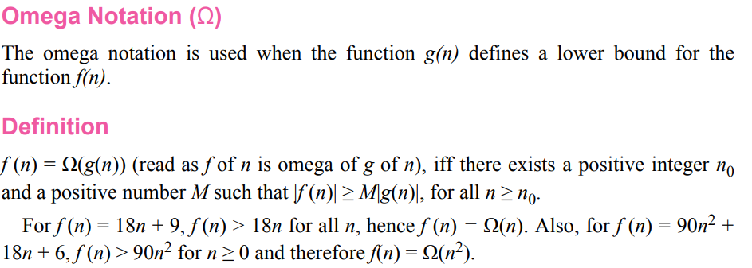
OTHER ASYMPTOTIC NOTATIONS FOR COMPLEXITY OF ALGORITHMS Ω, Θ, O

Slide 22
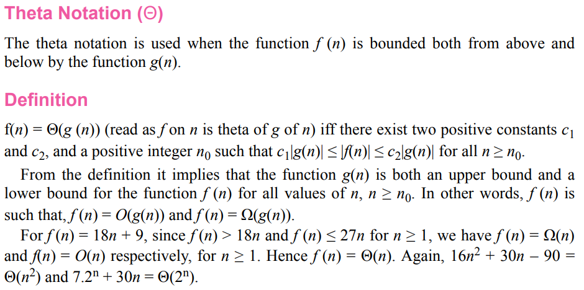

Slide 23
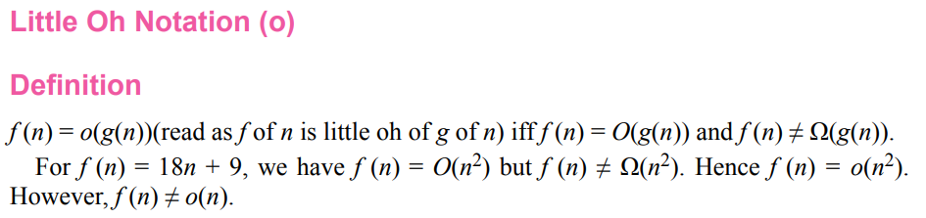
OTHER ASYMPTOTIC NOTATIONS FOR COMPLEXITY OF ALGORITHMS Ω, Θ, O

Slide 24
Important Sample Questions
Define data structure and its importance's.
List out the operations of data structure.
List out the examples of data structure.
What is algorithmic complexity and time-space complexity?
Define Big O(Ω), Theta Θ and Little oh (ο) notation for algorithmic complexity.

Slide 25
Next Week Topics
String Processing:
String Operations,
word processing, and
Pattern Matching Algorithms.

Slide 26
Thank You

